Slide 1













Sustainability@Continental
Greentech Zalaegerszeg 25 Sep 2020
www.continental.com
Mihály Nagy @ Continental
Notes:
Shape the Transformation for a Healthy Ecosystem for Mobility
To put it in a nutshell: Sustainability is about making the world a better place. To do so, we constantly need to challenge and change the status quo. Sustainable business practices and behaviors require a huge transformation of our societies and the global economy.

Slide 2




Global sustainability strategy at Continental
Carbon-neutral
value chain
latest
by 2050
100%
Emission-free
on the road
Closed resource cycles
Responsible sources
2
Sustainability@Continental 25 Sep 2020
Notes:
Our Goal: Carbon-neutral Value Chain until 2050
Continental is fully committed to the Paris climate agreement. We have therefore set ourselves the target of becoming completely carbon-neutral in our operational processes and value chains by 2050

Slide 3











Our sustainability strategy paves the way for the vision of a healthy ecosystem for mobility
Climate Protection
Carbon-neutral purchased electricity by end of 2020
Carbon-neutral production by 2040
Carbon-neutral value chain by 2050
Clean Mobility
Zero Tailpipe Emission Vehicles (ZTEV)
Reduction of other road emissions
Supporting EU sustainable finance taxonomy
Circular Economy
Closed resource cycles
Use of renewable and degradable resources
95% recycled waste by 2030
Sustainable Supply Chains
Minimizing negative social and environmental impacts in our supply chains
Traceability and risk-based due diligence
Good working conditions
Inspiring, motivating
and fair working conditions (incl. human rights in our own operations)
Green and safe factories
Sound operations not harming people or the environment; with
solid management systems
Innovations and Digitalization
Innovational strength
and new business models; shaping digital transformation and ethics
Product quality
High quality products
based on
product integrity and
quality management
Safe mobility
Enhanced road safety with technological solutions
to minimize severe road accidents and fatalities
Sustainable profits
Value generation
in the long-term and responsible distribution
of the value
Corporate Governance
Responsible management and fair business practices with
balanced view of different perspectives (diversity)
Corporate citizenship
Community engagement, donations and volunteering; engagement campaign “Sustainability Heroes”
3
Sustainability@Continental 25 Sep 2020
Notes:
Sustainability is a substantial element in the ongoing transformation of our industries. It stands for a balance between economic, ecological and social factors in corporate management.
In 2019, the Continental’s Executive Board approved the official sustainability strategy as an integral part of the group strategy.
The material key areas were identified based on a stakeholder survey and aligned with standards, frameworks and strategies of customers, investors and governments. Four strategic focus areas were derived:
Climate protection (to mitigate global warming by consequently reducing greenhouse gas emissions in our entire value chain and head for complete carbon neutrality in 2050)
Clean mobility (to protect the environment against any emissions resulting from vehicles by paving the way for zero-emission driving with our pioneering technical solutions / products)
Circular economy (to manage the scarcity of valuable resources by reducing, reusing, recycling and repairing of material)
Sustainable supply chains (to realize transparent, fair and environment-friendly supply chains with our business partners)
In addition to these four focus areas, we have identified eight further topics that are relevant for a sustainable business conduct: good working conditions, green & safe factories, innovations & digitalization, product quality, safe mobility, sustainable profits, corporate governance and corporate citizenship.
All these topics contribute to a healthy ecosystem of mobility and are closely interrelated. They are key elements in the current transformation phase of the company and will be crucially contributing to our long-term corporate success.
Continental works on the respective management systems for all twelve (four + eight) topics. The corresponding concepts, goals and key performance indicators are being developed successively. Please find more information in the Corporate Non-Financial Statement (part of Continental’s 2019 Annual Report (https://www.continental.com/en/investors/reports) and in the 2019 Sustainability Report (Please visit https://www.continental.com/en/sustainability/downloads)

Slide 4




Climate Protection: The Framework
Global Goals set by Paris Agreement
Carbon Neutrality targets
(& CO₂ Reduction targets)
of states
Carbon Neutrality targets
(& CO₂ Reduction targets)
of companies
Carbon Neutrality targets
(& CO₂ Reduction targets)
of investors
CO₂ regulation for many sectors in many regions
Climate Protection deemed supplier selection critereon
Climate Protection as an investment critereon
Accounting Standards for CO₂e
4
Sustainability@Continental 25 Sep 2020
Notes:
Continental is fully committed to the Paris climate agreement. We have therefore set ourselves the target of becoming completely carbon-neutral in our operational processes and value chains by 2050
https://hu.wikipedia.org/wiki/P%C3%A1rizsi_%C3%A9ghajlatv%C3%A9delmi_egyezm%C3%A9ny

Slide 5


Climate Protection:
The Challenge
Limit global warming to well below 2° Celsius
At best below 1.5° Celsius
Global Carbon Neutrality in the 2nd half of the century
Mitigate the effects of climate change
50,000,000,000 tons of CO₂e p.a.
5
Sustainability@Continental 25 Sep 2020

Slide 6



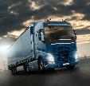






125+ Mio. t CO₂e reported Total Carbon Footprint of Continental
(Scope 1,2,3) – 2019 figures in Mio. t CO₂e
Purchased Goods
(materials & components)
Upstream transport
Downstream transport
Use-of-sold products
(in vehicles)
End-of-Life Treatment
3.22 Mio t
Own emissions Scope 1+2
16 Mio t
0.84 Mio t
Direct emissions Scope 1
~100 Mio t
Scope 3
0.6 Mio t
0.6 Mio t
4 Mio t
2.38 Mio t
Indirect emissions Scope 2
0.5 Mio t
Supply chain of energy supply
0.1 Mio t
Business Travel
0.02 Mio t
Waste
Figures audited by KPMG
7 categories of Scope 3 not reported yet
6
Sustainability@Continental 25 Sep 2020
Notes:
We see the achievement of this target as a key requirement for the corporation’s future viability. In a first step, we will switch all externally sourced electricity in global production to renewable energy by the end of 2020, including through energy attribute certificates. The aim then is to also make all of Continental’s production processes carbon-neutral by 2040, as well as the entire value chain by 2050. The value chain covers in particular our supply chains, logistics and the use of our products. The most important levers for these targets are the use of renewable energies, the development of new technologies and increases in efficiency.
In 2019, electricity from renewable energy sources accounted for around 5.3% of all electricity purchased. Our own CO2 emissions (Scope 1 and 2 of the Greenhouse Gas (GHG) Protocol) decreased to 3.22 million metric tons (PY: 3.35 million metric tons). These include direct CO2 emissions from fossil fuels (Scope 1 of the GHG Protocol) and indirect CO2 emissions from the generation of purchased electricity, steam and heat (Scope 2 of the GHG Protocol). The reduction in 2019 was the result of a decline in energy consumption due mainly to the current economic situation.

Slide 7

Continental matters for global climate protection efforts
<0.01%
Emissions related to our production
(Scope 1+2)
3.22 Mio t CO₂e
Upstream: 16+ Mio t
Downstream: 105+ Mio t
Emissions related to
our business activity
(Scope 1+2+3)
0.2-0.3%
125+ Mio t CO₂e
16-20%
Emissions related to the entire transport sector
(indirectly influenced but out of
our balance sheet)
8,000-10,000 Mio t CO₂e
100%
Global anthropogenic emissions
(out of our balance sheet)
~50,000 Mio t CO₂e
7
Sustainability@Continental 25 Sep 2020

Slide 8

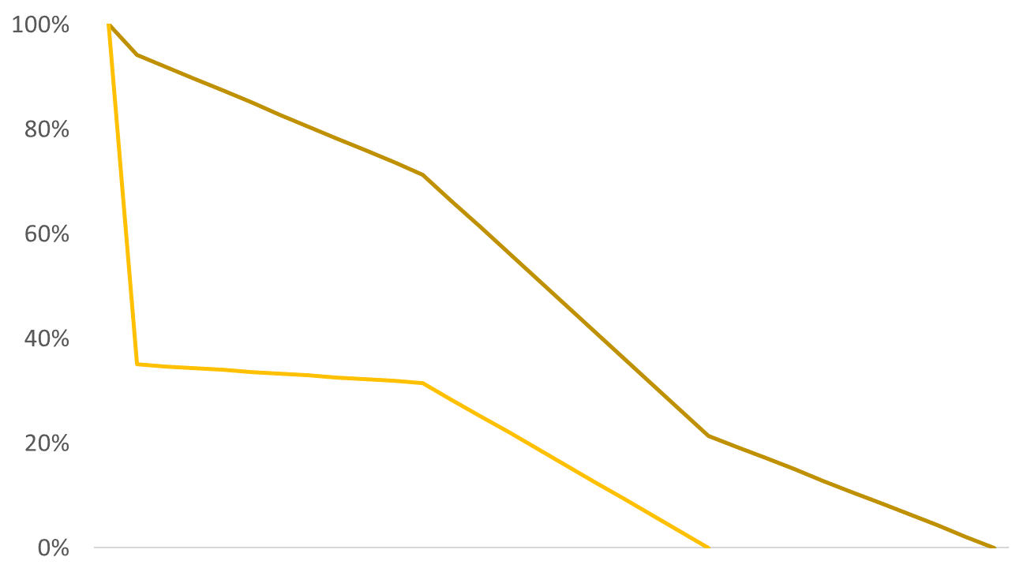


Continental’s Clear Pathway Towards Carbon Neutrality fully in line with the Paris Agreement
Our 3 climate action targets
Our levers
Carbon-neutral purchased electricity by end of 2020
Carbon-neutral production by 2040 (Scope 1+2)
Carbon-neutral value chain by 2050 (Scope 3)
Radically increased use of renewables
Continental will join the RE100 campaign
Technological game changers
e.g. electric/fuel cell cars, recycled and renewable materials
Modelled reduction pathways, indexed
Scope 1+2
CO₂ from own production
3.22 mn metric tons CO₂ in 2019
Scope 3
CO₂ from value chain: use of products, supply chain, logistics and other processes
>120 mn metric tons CO₂ in 2019
Innovative efficiency improvements
for own production, logistics, existing products and supply chains
2020
2040
2050
Sustainability@Continental 25 Sep 2020
Notes:
https://www.continental.com/en/sustainability/news/news-2020/continental-to-join-the-re100-initiative-224324

Slide 9

Sustainability highlights at Continental companies in Hungary
Modernization of road- and production hall lightning
Development of production infrastructure and electricity
Bike to work internal campaign for employees
Replacement of natural sources of caoutchouc- Taraxa in global tyre production
Improve the recycling rate of scrap
Automotive thermal management development
Energetical measurement systems
Reduce the weight of automotive products
Energetical measurement systems
Different projects to reduce energy consumption
„Sustainability Heroes” internal campaign- employees education and call to action
…
Sustainability@Continental 25 Sep 2020

Slide 10

Make attention on climate changes- Continental partnering Extreme E
Sustainability@Continental 25 Sep 2020

Slide 11
Thank you for your attention!

